Slide 1
CAR Administrator Calibration Meeting - Good and Bad CARs -
November 26 2012
Team A: Ronald Tse, Ravi V, Jacky Wu, Kila Yang, Motomu Kawano

Slide 2
Agenda
Good CARs
No. 123911157 / V Ravichander
No. 123910338 / Jacky Wu
Bad CARs
No. 123910554 / Kila Young
No. 123910354 / Ronald Tse

Slide 3
Good CARs: No. 123911157 (V Ravichander)

Slide 4
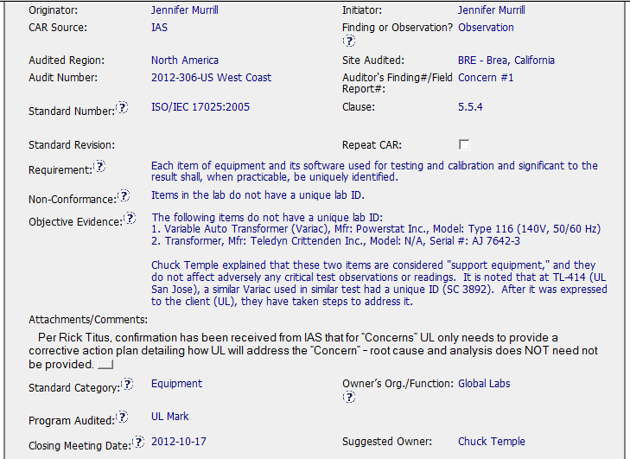
Good CAR No. 123911157

Slide 5
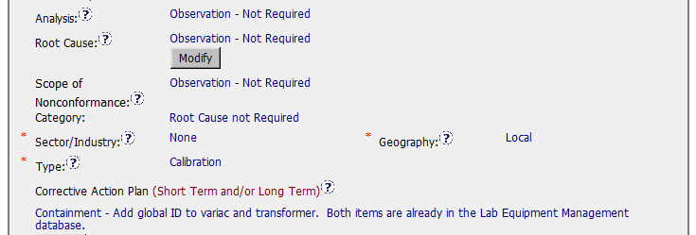
Good CAR No. 123911157
Analysis & Root Cause : Not Required
Scope of Nonconformance: Not required or Same as NC
Category: Root cause not required
Corrective action plan: Fixed the objective evidence

Slide 6
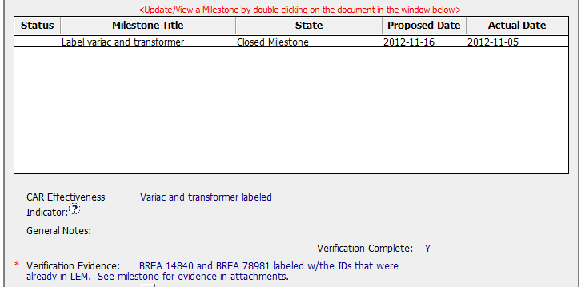
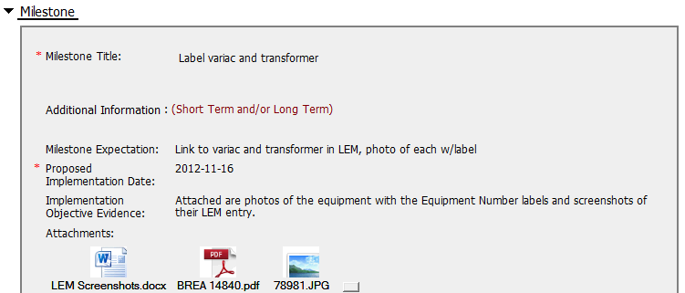
Good CAR No. 123911157
Milestone: Completed per milestone expectation
Verification: Occurred immediately after acceptance of the last milestone

Slide 7
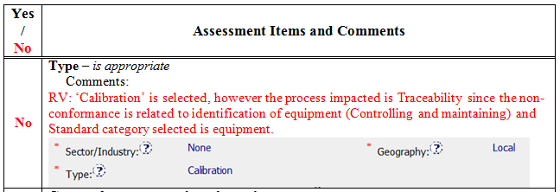
Good CAR No. 123911157 Discussion

Slide 8
Good CAR : No. 123910338 (Jacky Wu)

Slide 9
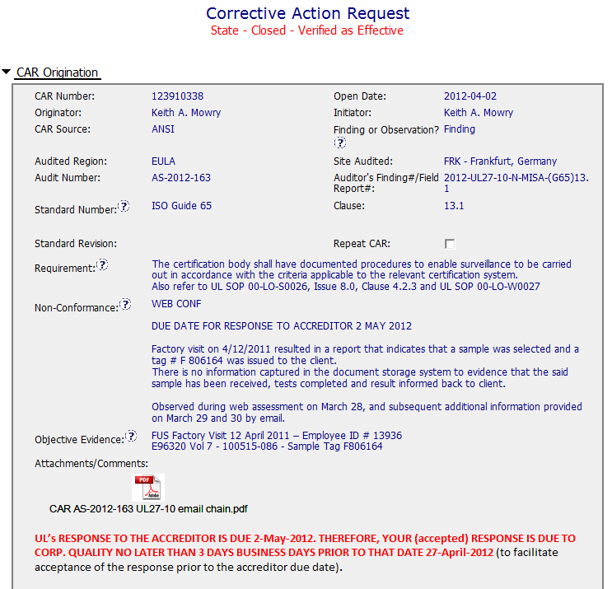
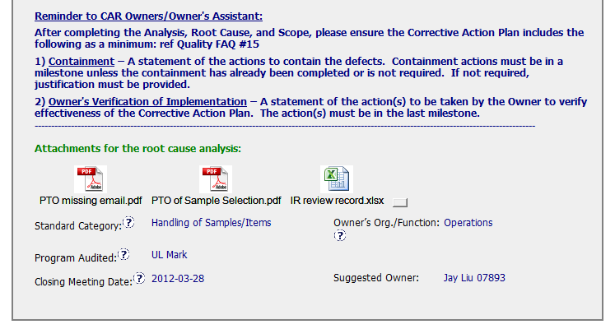
Sample 1 - Good CAR No. 123910338

Slide 10
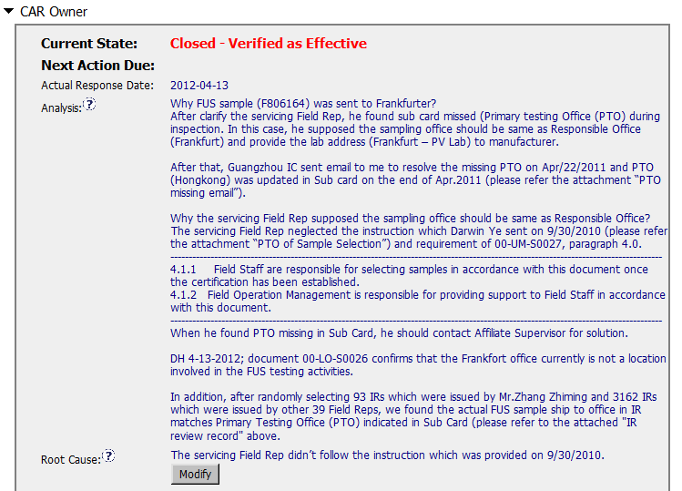
Sample 1 - Good CAR No. 123910338
RCA has been properly used (i.e. 5WHYs). Certainly, room for improvement, more WHY could still be asked, e.g. WHY didn’t Field Rep follow the sampling requirement as documented in FUS SOP “00-UM-S0027, paragraph 4.0”?
Agreed. The root cause is clearly identified although other area could also be considered. (e.g. FUS Sample Team in CAS - missing PTO information in Sub-card.)
Notes:
00-QA-S0006 (#18.0) - Corrective Action Request Process

Slide 11
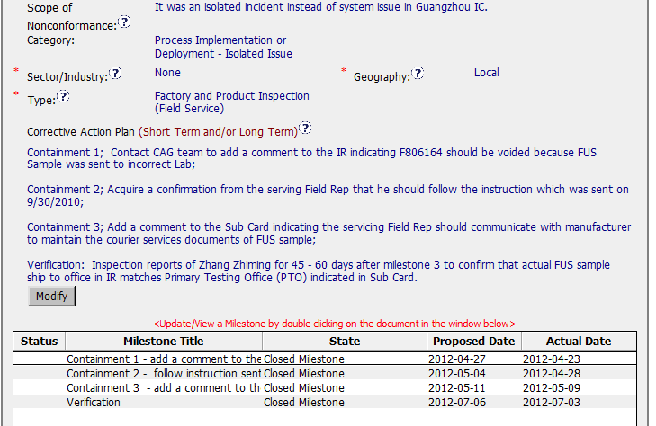
Sample 1 - Good CAR No. 123910338
Agreed. Outspreading investigation is included.
Okay, but “Sample Handling Issue” is better – more specific.
Agreed.
1. Okay, but it seems to be limited within Field Ops only. In fact, FUS Sample Team in CAS might also be an area working on (i.e. missing PTO information in subscriber card).
2. Corrective action could still be considered and added. e.g. Training and/or regular meeting to emphasize this discrepancy to all Field Reps in IC as reminder, not limited to an affected servicing Field Rep.
Notes:
00-QA-S0006 (#18.0) - Corrective Action Request Process

Slide 12
Sample 1 - Good CAR No. 123910338
Agreed, with adequate supporting evidence in containment actions 1-3 to demonstrate that those 3 containments are properly implemented, e.g. attached e-mail from customer and IR and subscriber card records.
Verification milestone is added with sufficient time, i.e. almost 2 months.
Both milestone expectations and fulfillment are appropriately defined and completed (prior to due dates) respectively.
Notes:
00-QA-S0006 (#18.0) - Corrective Action Request Process

Slide 13
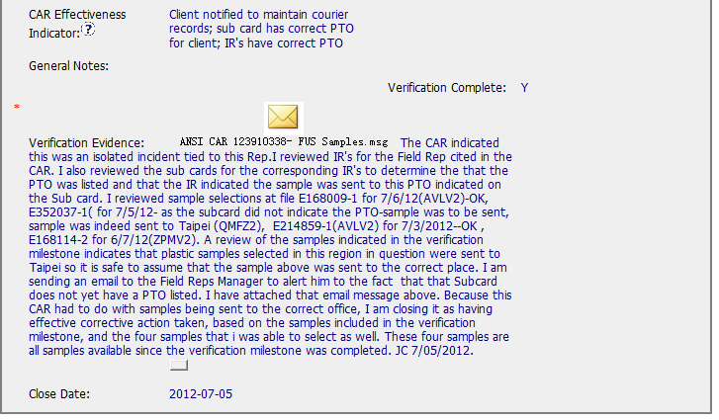
Sample 1 - Good CAR No. 123910338
1. Agreed, both fields of “CAR Effectiveness Indicator” and “Verification Evidence” are filled.
2. Sampling of additional FUS sample (i.e. 4) for review PLUS the owner’s verification, it is noted that verification process in this CAR is sufficient.
Notes:
00-QA-S0006 (#18.0) - Corrective Action Request Process

Slide 14
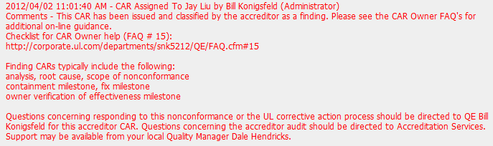
Good Practice - CAR No. 123910338
Good practice is seen in the “Document History” for additional guidance to CAR Owner.
Notes:
00-QA-S0006 (#18.0) - Corrective Action Request Process

Slide 15
Bad CAR : No. 123910554 (Kila Yang)

Slide 16
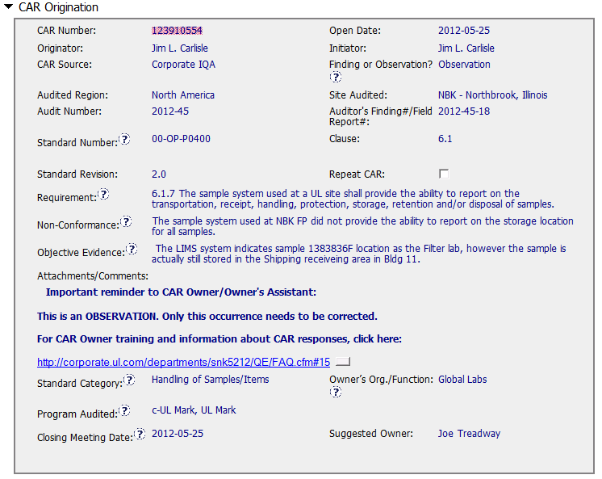
CAR Needing Improvement - No. 123910554

Slide 17
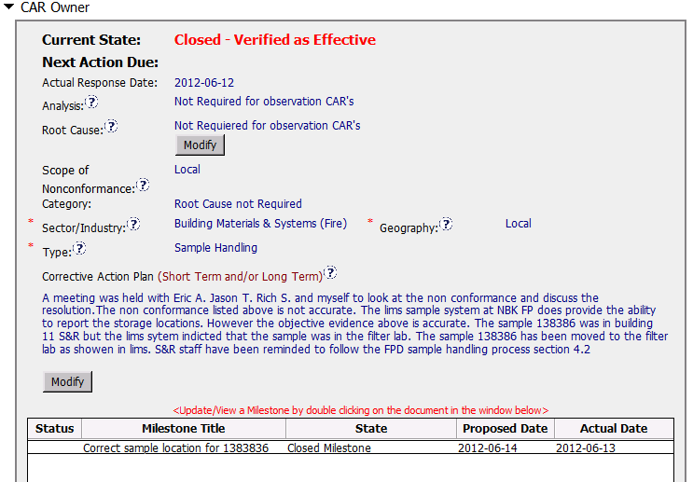
CAR Needing Improvement - No. 123910554
Notes:
00-QA-S0006 (#18.0) - Corrective Action Request Process

Slide 18
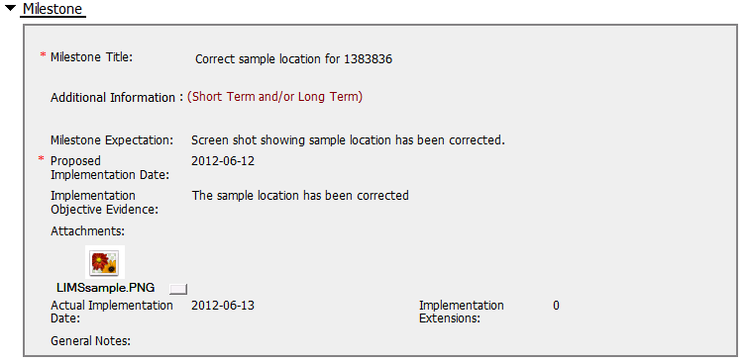
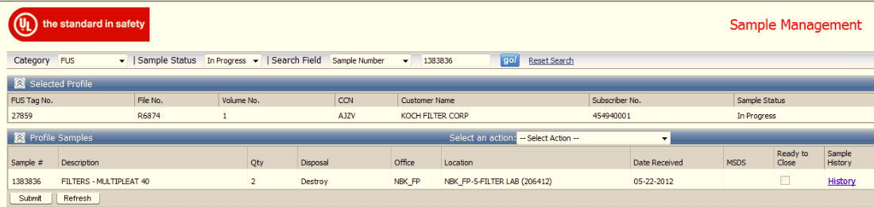
CAR Needing Improvement - No. 123910554
Inappropriate supporting evidence provided - The sample location of LIMS is same as the non-conformance objective evidence which this CAR addressed. (LIMS in Filter lab)

Slide 19
CAR Needing Improvement - No. 123910554
Recommendation –
Milestone – Implementation Objective Evidence
Provide the photo of sample shelve with such sample No. or sample login/out sheet to prove this sample has been moved to Filter lab.
The CAP states that “S&R staff have been reminded to follow the FPD sample handling process section 4.2”. It’s recommend to provide the evidence, ex) reminder email or meeting minutes as evidence.

Slide 20
Bad CAR : No. 123910354 (Ronald Tse)

Slide 21
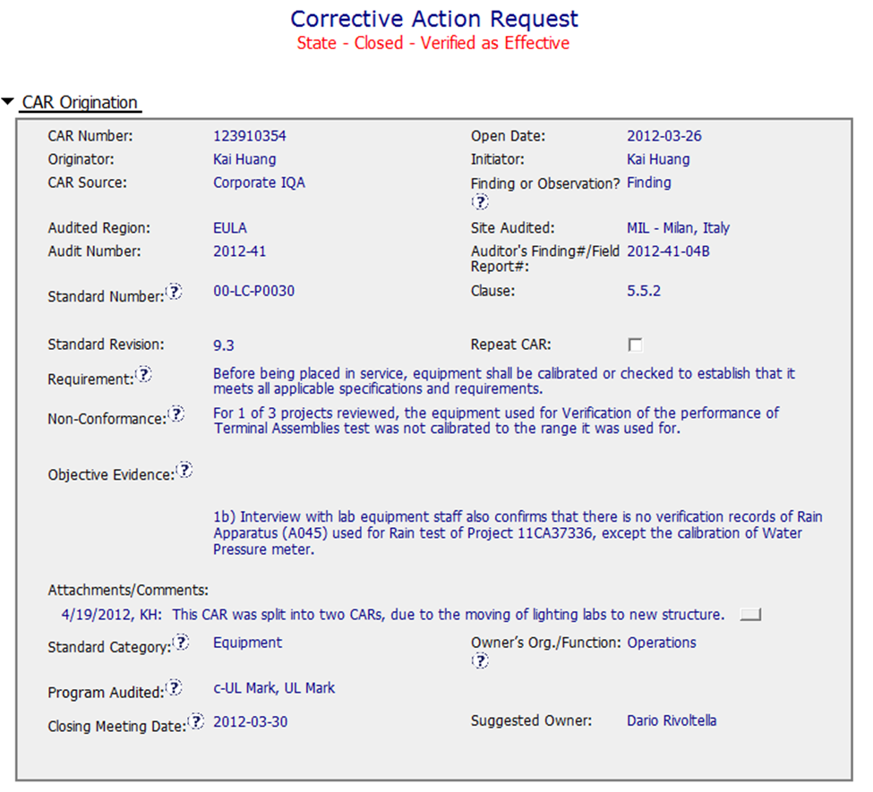
Sample 2 - Bad CAR No. 123910354

Slide 22
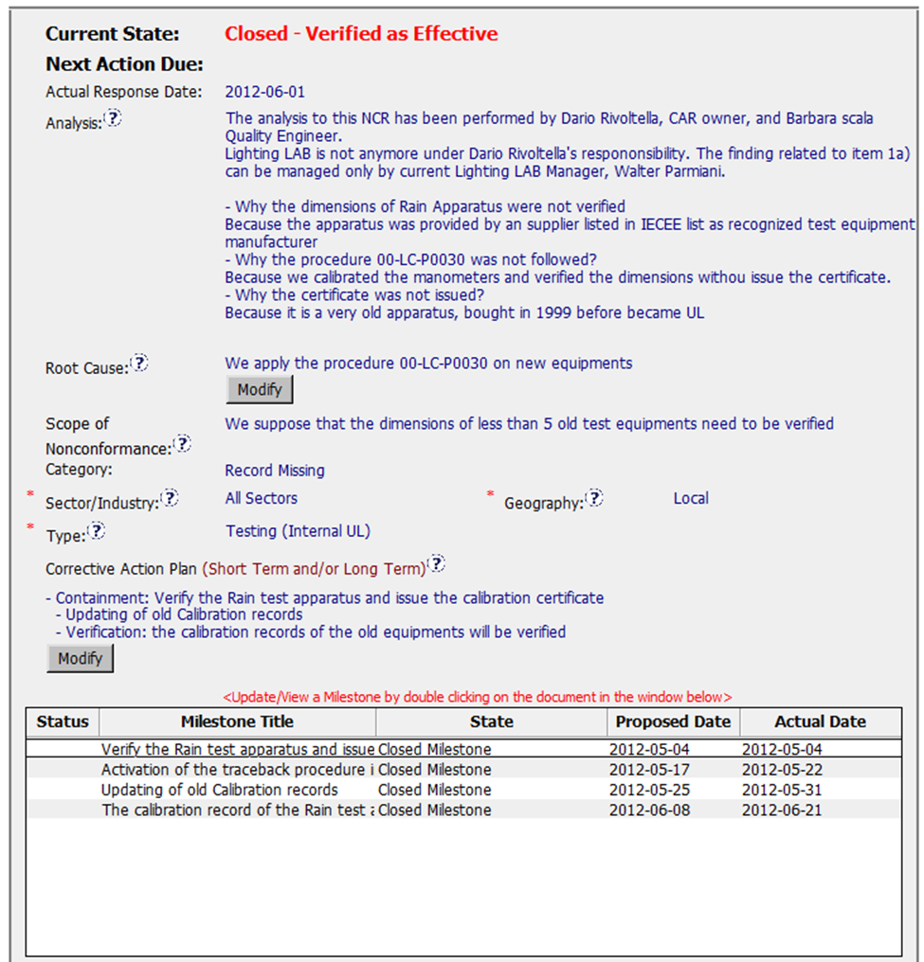
Sample 2 - Bad CAR No. 123910354
The “5 WHYs” approach hasn’t been utilized well because it doesn’t seem that those WHYs are able to link up each other and in sequence. e.g. why IECEE list of recognized test equipment manufacturer could override the requirements stated in the SOP?
Re-address the way pending to action doesn’t mean it is the root cause… As of above, the question is still to be “Why current SOP related to this incident hasn’t been adopted and followed thoroughly”?? The root cause is not clearly defined.
The widespread of the discrepancy has not been addressed in this field. e.g. would the calibration status of other old test equipment be checked, and has the discrepancies been identified if any? And most importantly, any consequential effect to the test data and result of the previous projects by use of this test equipment?
Notes:
00-QA-S0006 (#18.0) - Corrective Action Request Process

Slide 23
Sample 2 - Bad CAR No. 123910354
Instead of “Record Missing”, would “Equipment (Hardware or Software) Calibration…” or “Process Implementation or Deployment Issue” be better to address this discrepancy?
Should “Calibration” be a better choice instead of choosing “Testing (Internal UL)”?
Not clearly illustrated in the field of “Analysis” to support it to be “Local”.
However, if it relates to the Corrective Action and Preventive Action, it is insufficient. First of all, have other old test equipment been properly calibrated? If not, have they been calibrated now? If yes, attach with calibration report as supporting evidence.
The most important thing is that why and how this incident happens? Is this an isolated case or systemic issue, competency issue / process issue or others? Based on the written responses in this CAR, it doesn’t address any of these areas…
The corrective action hasn’t addressed why old test equipment hasn’t been calibrated…
Notes:
00-QA-S0006 (#18.0) - Corrective Action Request Process

Slide 24
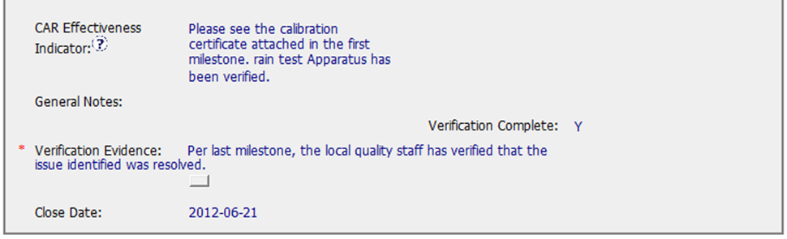


Sample 2 - Bad CAR No. 123910354
No supporting evidence attached for the 2nd milestone “Activation…” It doesn’t fulfill the milestone expectation “The records for control of nonconforming work process”.
And in the last milestone, why the verification is limited to the affected test equipment, i.e. Rain Tester, how’s about other test equipment documented in the 3rd milestone?
Suggest adding comment in this field or field of “This CAR References” to illustrate that the handling of nonconformance (1a) is managed via another CAR, i.e. CAR #.
Both fields of “CAR Effectiveness Indicator” and “Verification Evidence” are filled, however, it doesn’t seem that the root cause of N/C is properly identified and the N/C is managed by proper corrective and preventive actions. The effectiveness of this CAR handling is in doubt, by an unclear and insufficient rationale...
No extension is noted. Other than this, suggest sending e-mail in advance to remind CAR Owner separately to avoid CAR overdue and/or escalation. Put any communication into the CAR DB as evidence.
Notes:
00-QA-S0006 (#18.0) - Corrective Action Request Process

Slide 25
Thank you!!!

